Slide 1

ChAMps Travel
Your time is valuable, so is your money.
Project 1
Abraham Benaim
Craig Hall
Mon Alarcon

Slide 2
You deserve a holiday..
After wrapping up a project you’ve been working hard on all year, you’ve just been given a bonus! You decide it’s the perfect opportunity for a vacation. You also realize this might be the perfect excuse to finally visit some of your friends living abroad.
Now you’re faced with planning a trip:
While you’re dates are flexible, you know you want to spend 4 days visiting your college roommate in London, UK and 3 days with your best friend in Madrid, SP. You also need to spend 6 days in Paris, FR, where your girlfriend is studying. You don’t care in what order, you just want the cheapest route that won’t be a headache. If you’re leaving from Miami, FL, on December 1, 2019, which route would be the most cost efficient, so you don’t end up spending you’re entire bonus?
Luckily, you’re coworker is in the middle of a Data Analytics Bootcamp, and happens to be working on an app that can figure this out for you!

Slide 3



Slide 4
Methods and Tools
Define the problem:
It takes too long for an individual to manually search different iterations of flight routes to the same set of cities
Although there multi-city flight searches exist, the users have to have defined dates which leads to opportunity costs of finding a cheaper priced route
User may still not get the best available options if manually searching
Identify Data sources:
User input for search parameters
Number of adults; number of infants; origin city; date of departure; destination cities and length of stay
Flight information / prices from travel search engine

Slide 5

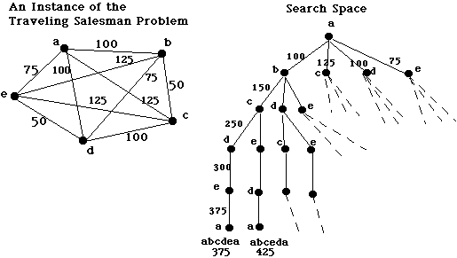
The Traveling Salesperson Problem
If each node is representative of a destination city, our application will have to query for the cheapest flights to and from each of the cities; the origin city is the first and last node visited.
The output of possible routes would be a factorial of the number of cities (for example: if cities = 4, 3 destination cities plus the origin city;
then cities - 1! would result in 6 routes.)
n =4 ; 3!= 3 * 2 * 1 = 6
Image from trincoll.edu

Slide 6
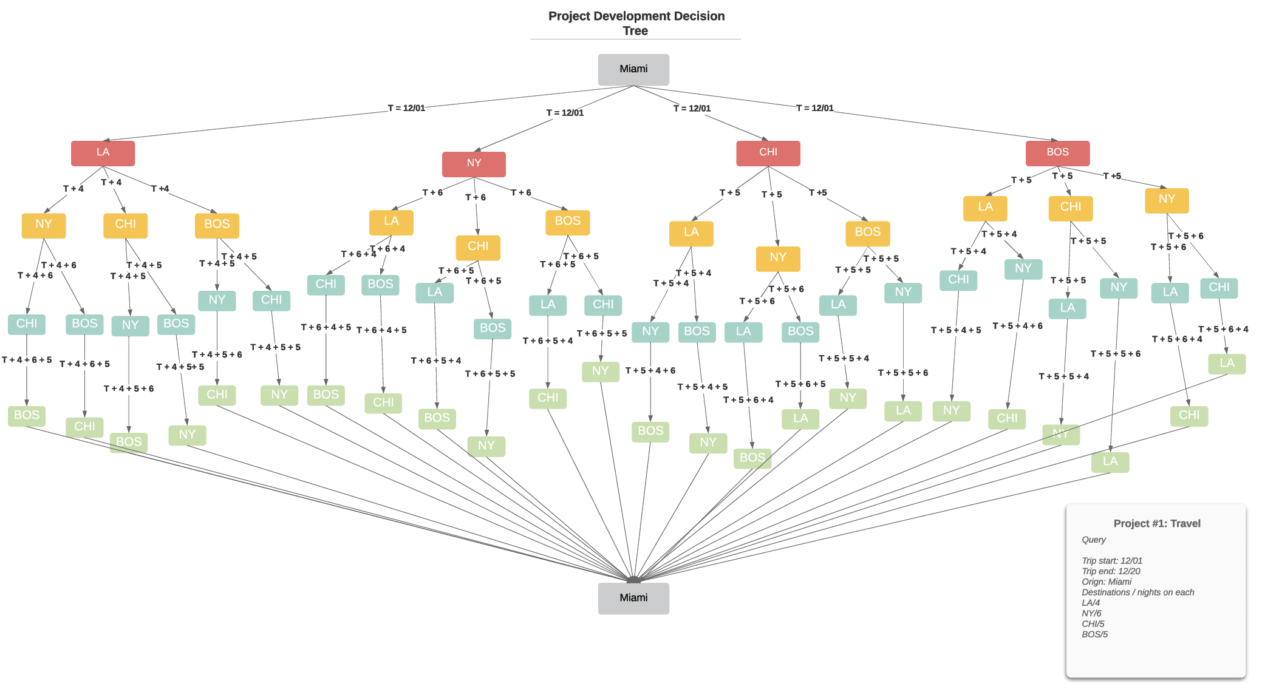
limitations:
The more cities you add; the more iterations exist; the longer the query will take
“The traveling salesman problem is easy to state, and — in theory at least — it can be easily solved by checking every round-trip route to find the shortest one. The trouble with this brute force approach is that as the number of cities grows, the corresponding number of round-trips to check quickly outstrips the capabilities of the fastest computers. With 10 cities, there are more than 300,000 different round-trips__.__ With 15 cities, the number of possibilities balloons to more than 87 billion.” (Wired.com).

Slide 8


Slide 9
Methods and Tools
Extract, Transform, Load:
Use a dynamic API query to Hipmunk (online travel search engine) to get data.
Data Staging:
Create lists and data frames of flight information and itineraries using conditional loops to iterate through various permutations of the user input in the queries.
Organize data into Data Frames that allow us to sort the permutations by cheapest flights per route and select the cheapest route with the lowest agony score.
Geopy module to get Lat and Long for each city
Visualizations:
Use Plotly module to visualize flight path.

Slide 11


Slide 12
Resources
Thank you!
Stackoverflow
Github
http://www.cs.trincoll.edu/~ram/cpsc352/notes/heuristics.html
https://www.wired.com/2013/01/traveling-salesman-problem/
https://www.geeksforgeeks.org/travelling-salesman-problem-set-1/

